Slide 1
The ”motherhood penalty” in academia
Peyton Lab Spring 2026 DEI
Maulee Sheth
April 28th, 2026

Slide 2

Some optimistic numbers
Percent women
Baccalaureate
Master’s
Doctoral
43% | 34% | 12%
1966
57% | 59% | 51%
2001
60% | 64% | 59%
2026
National Center for Education Statistics; *Stats among US citizens

Slide 3
Some other not-so-optimistic numbers
1 in 3
women exit academia following motherhood
23%
Women’s likelihood of having a tenured position drops and remains
lower
than men’s following parenthood, eight years later
44%
Of tenured faculty,
70% of men are married with children compared with
of women
Williams and Ceci, American Scientist, 2014;
Cairo et al., LSE, 2026; Goulden and Mason, Proceedings of the PAESMEM, 2004

Slide 4
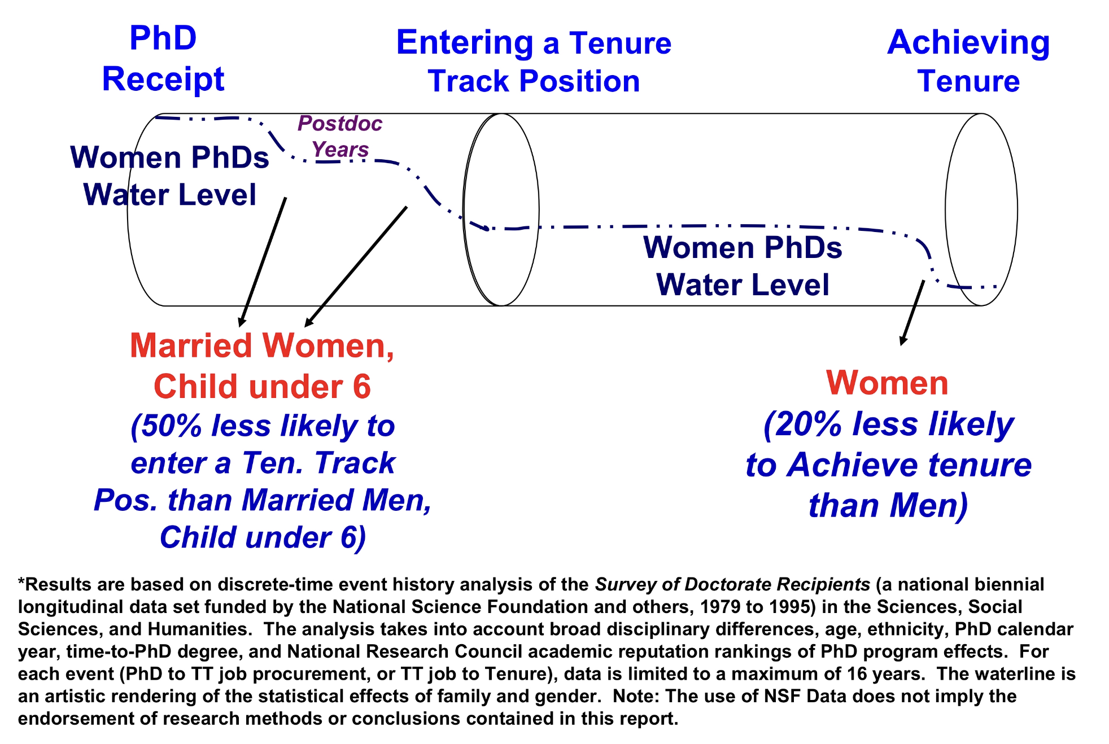
There are “leaks” in the pipeline to tenure
Goulden and Mason, Proceedings of the PAESMEM, 2004

Slide 5
Do babies matter?
M. Goulden, M. A. Mason, N. Wolfinger, 2004
DATA: Survey of Doctorate Recipients (SDR), United States
Interviews of ~10% subsample of all U.S. PhD recipients in the sciences and social sciences by the NSF and NIH, starting in 1973
Between 1973 to early 2000s, NSF resurveyed all individuals previously included in the SDR and added a new sample of individuals who had received PhDs since the preceding SDR interview
More than 160,000 participants are represented nationally
GOAL: To pinpoint more closely when women leak out of the pipeline to tenure
Whether men and women progressed at different rates to tenure
Whether family formation affected these career patterns

Slide 6
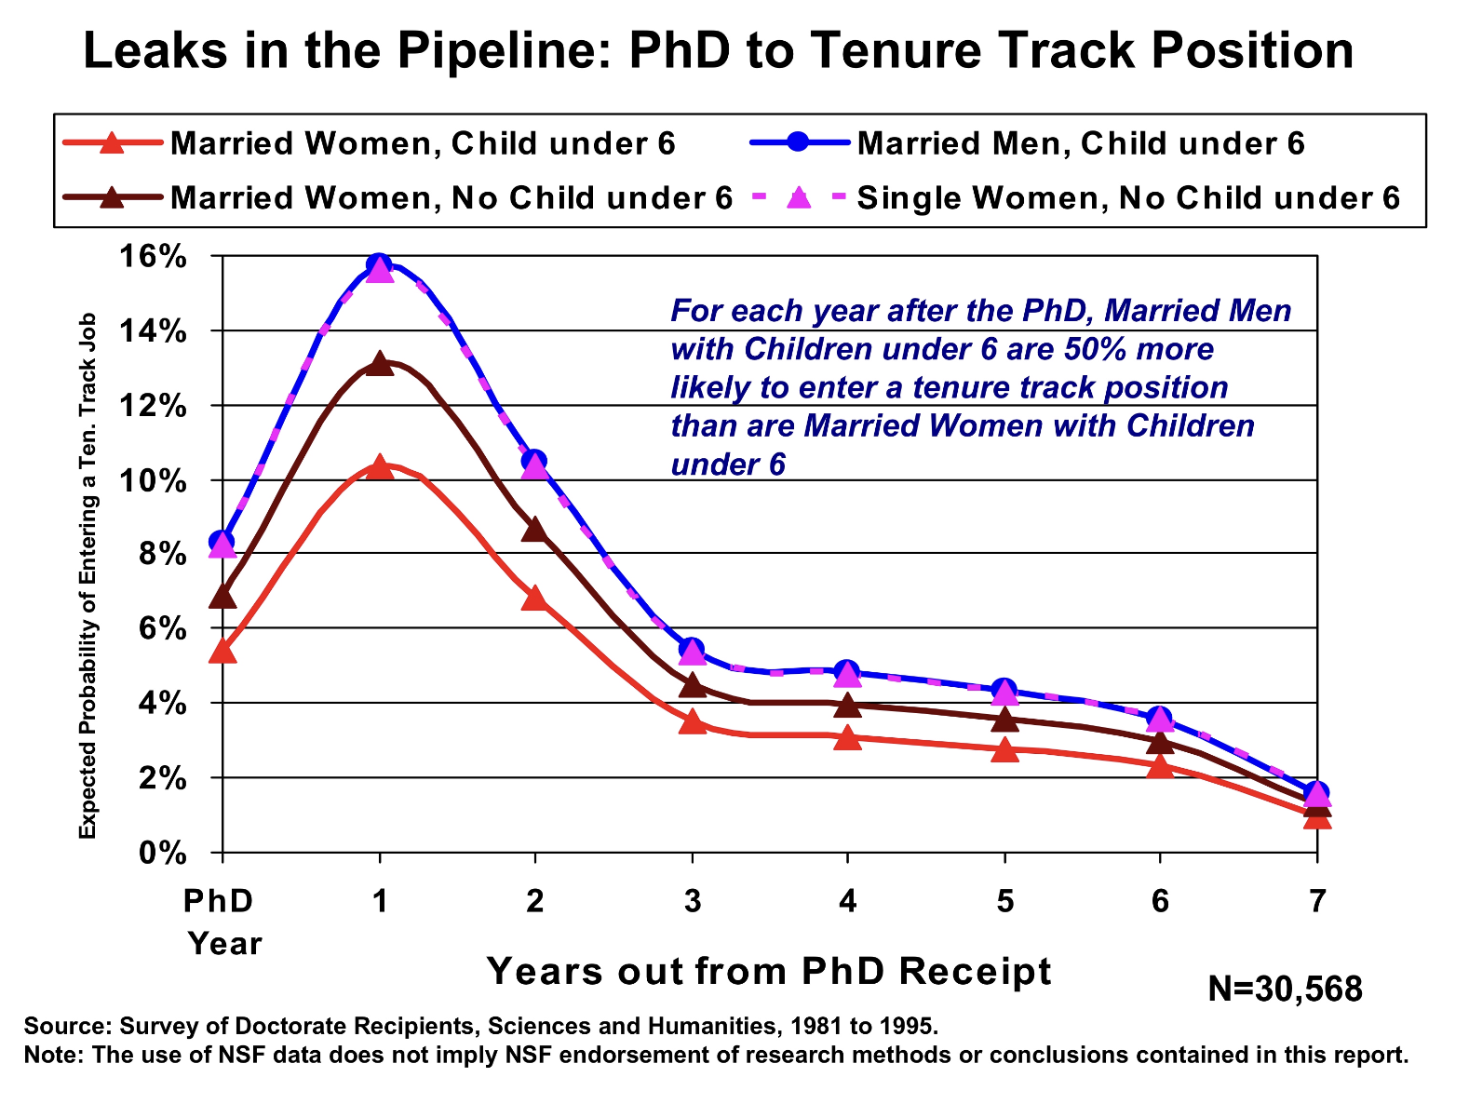
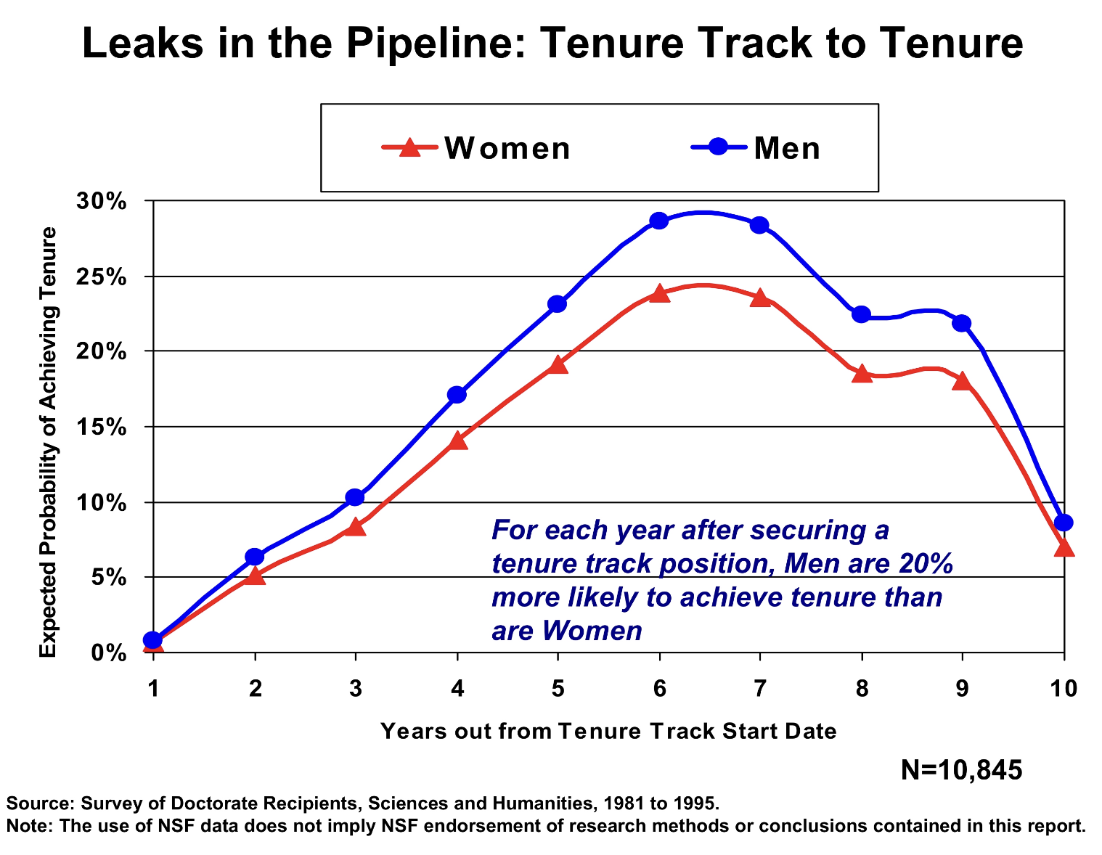
For women, babies and marriage, are clear leaks in the tenure pipeline
Even more worrisome because it is earlier in the pipeline and thus has a compounding effect
Goulden and Mason, Proceedings of the PAESMEM, 2004

Slide 7
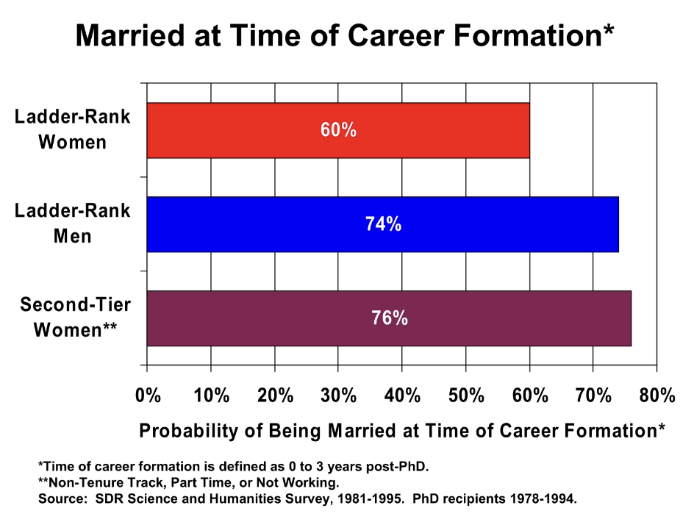
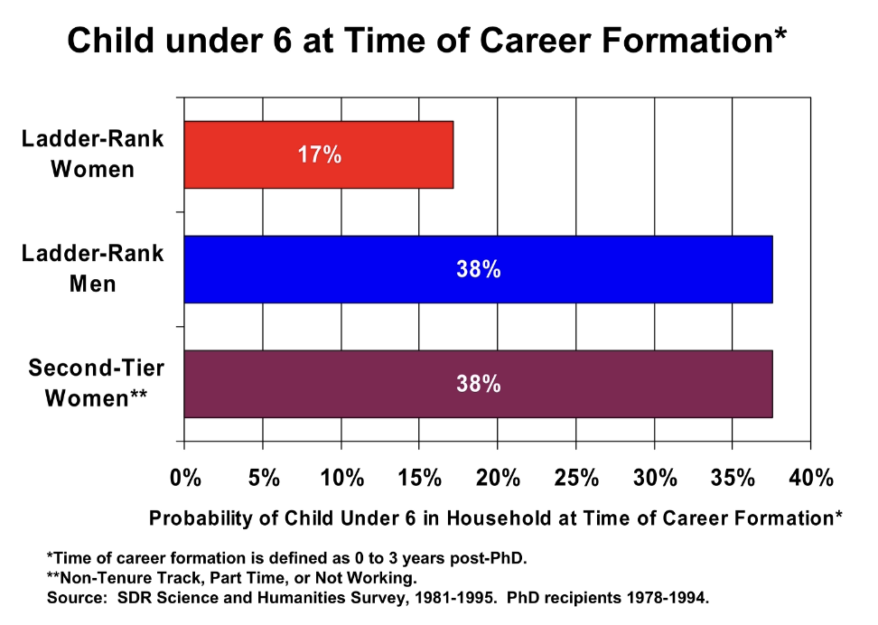
Effects of ladder-rank faculty careers on family patterns are differential
Goulden and Mason, Proceedings of the PAESMEM, 2004

Slide 8
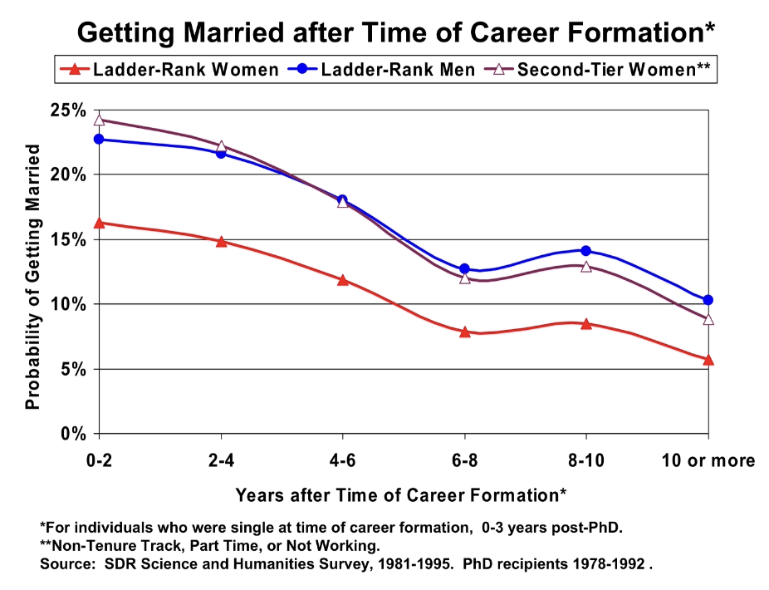
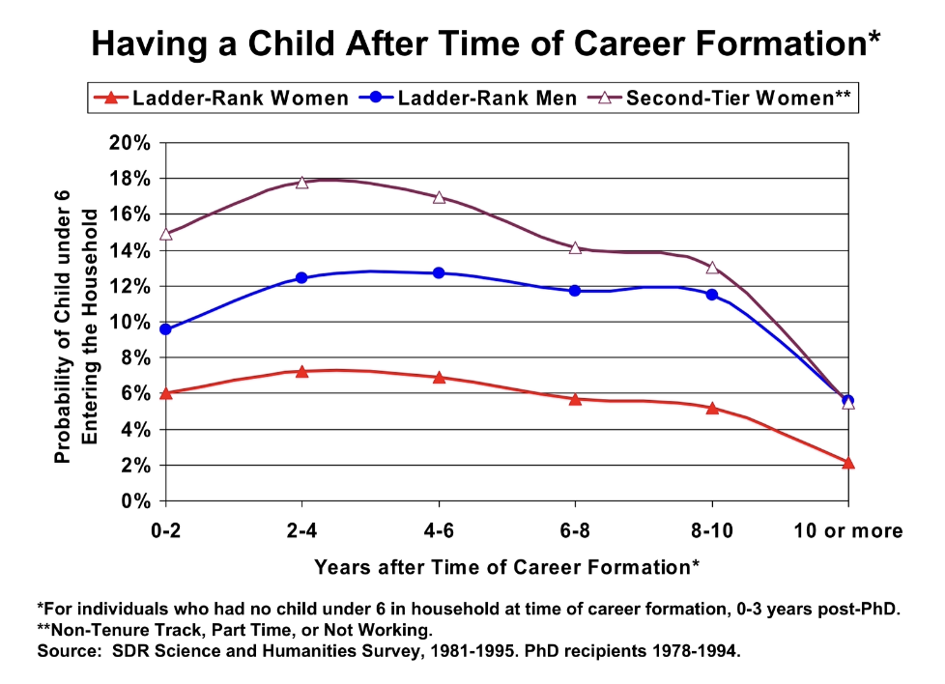
The effects persist post formative years
Goulden and Mason, Proceedings of the PAESMEM, 2004

Slide 9
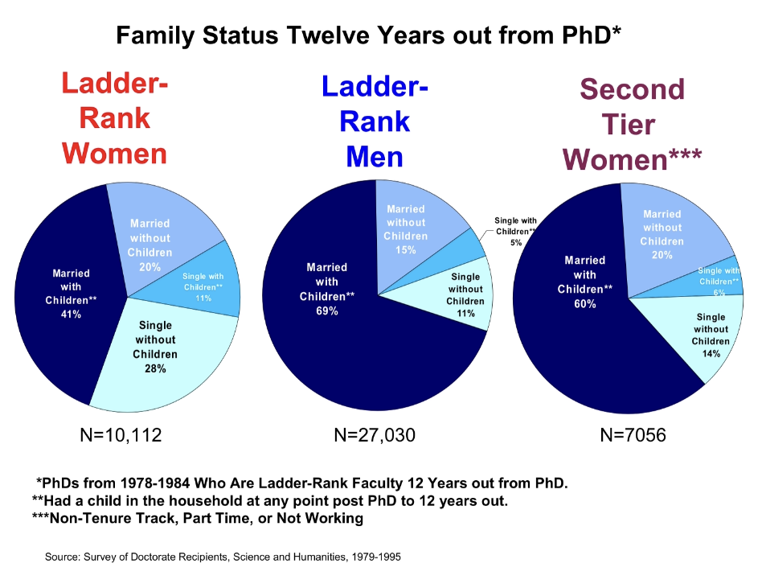
A minority of ladder-rank women are married and have children
Goulden and Mason, Proceedings of the PAESMEM, 2004

Slide 10
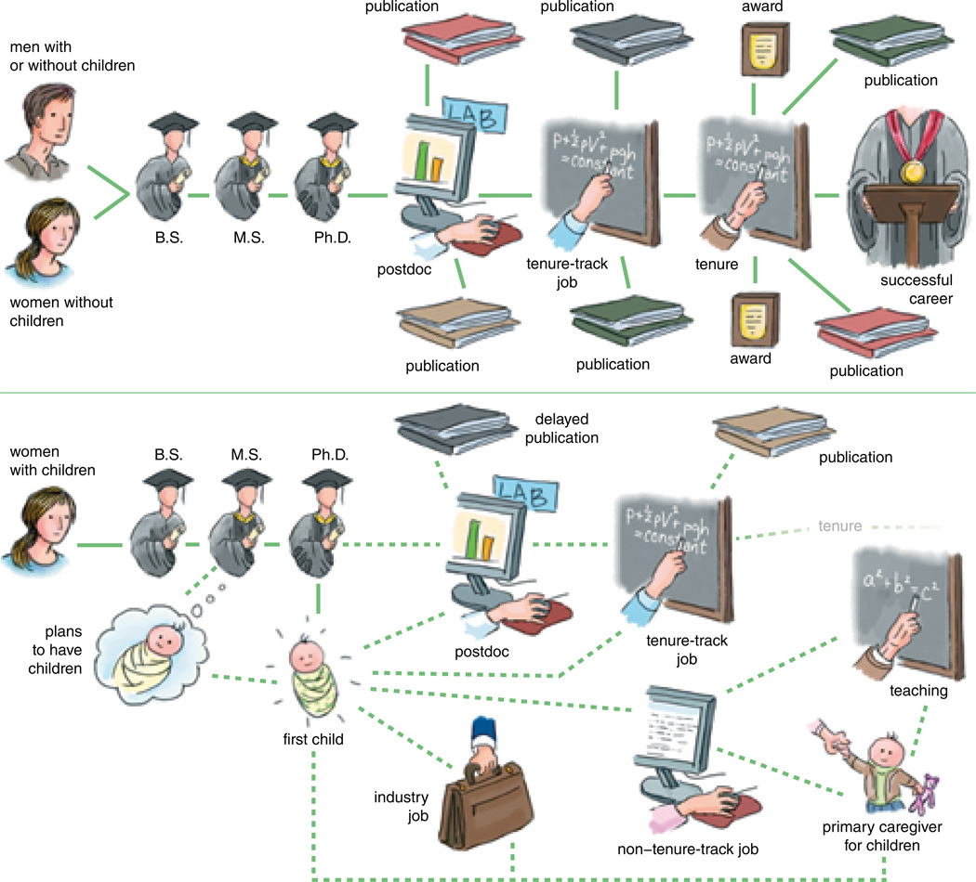
There is a clear path divergence for women with children
What are the sources of these child penalties?
Williams and Ceci, American Scientist, 2014;

Slide 11
Parenthood and the career ladder: evidence from academia
S. Cairo, R. Ivandic, A. S. Lassen, V. Tartari, 2026
DATA: Administrative registers, Denmark
Demographic and family registers + labor market information + educational registers for researchers from 1996 to 2022
Collective bargaining agreements from the Danish Union of Academics
Elsevier Scopus
Cross-sectional survey at Danish Universities
The estimation sample consists of 13,347 individuals
GOAL: To trace the dynamics of child penalties from four years before to eight years after the birth of the first child, using a sample of researchers, starting from their PhD, who became parents
Child penalties – the differential effects of parenthood on women’s and men’s likelihood of staying in academia, and having tenure

Slide 12
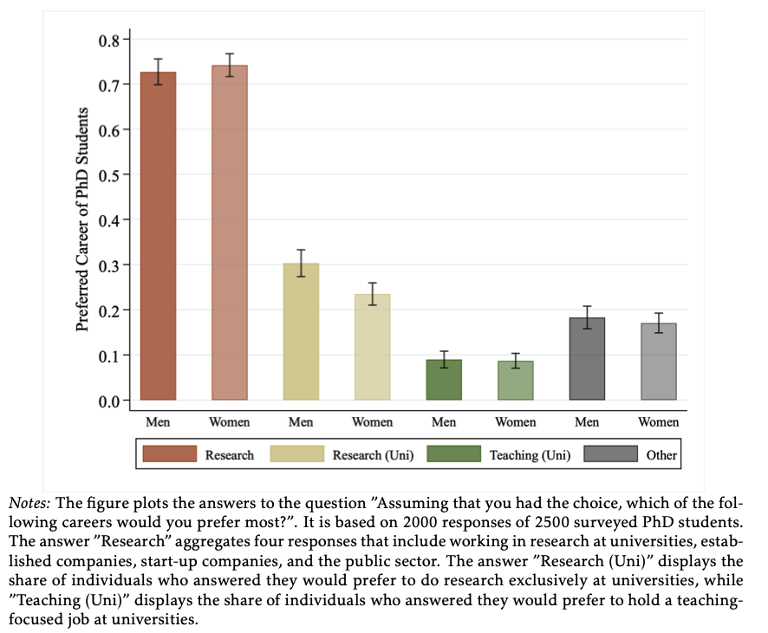
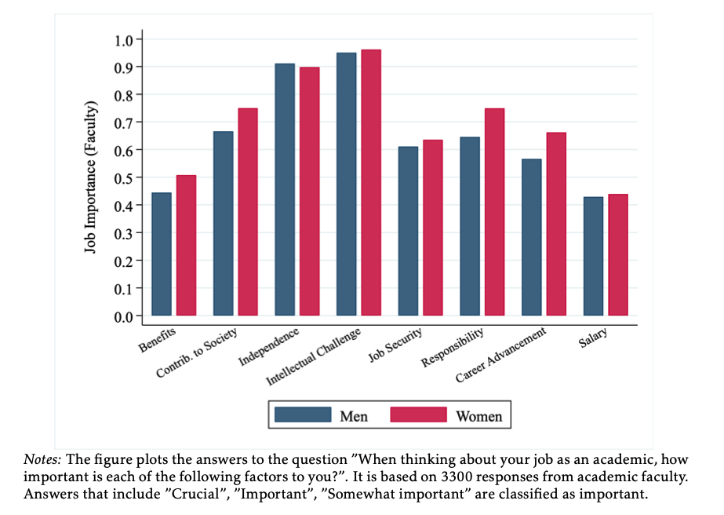
Aspirations or preferences are not driving the leaky pipeline
Cairo et al., LSE, 2026

Slide 13
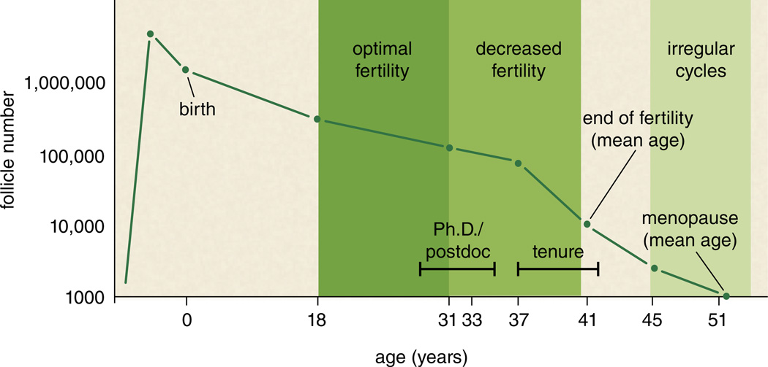
What is – the clash of timelines
A female faculty member who is interested in starting a family finds that her “biological clock” is directly at odds with her “tenure clock”.
Williams and Ceci, American Scientist, 2014

Slide 14
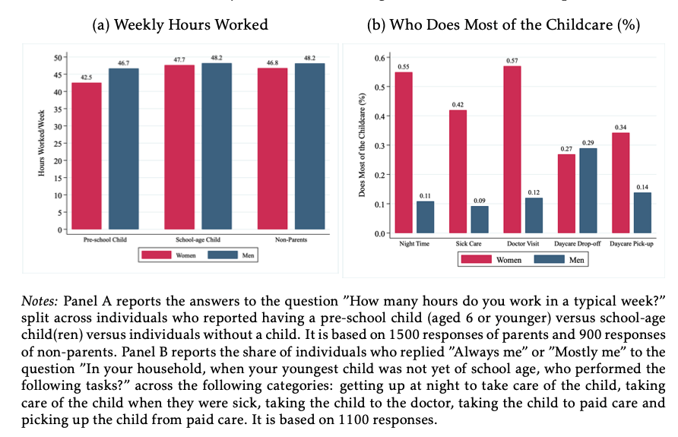
What is – Childcare constraints
Cairo et al., LSE, 2026

Slide 15
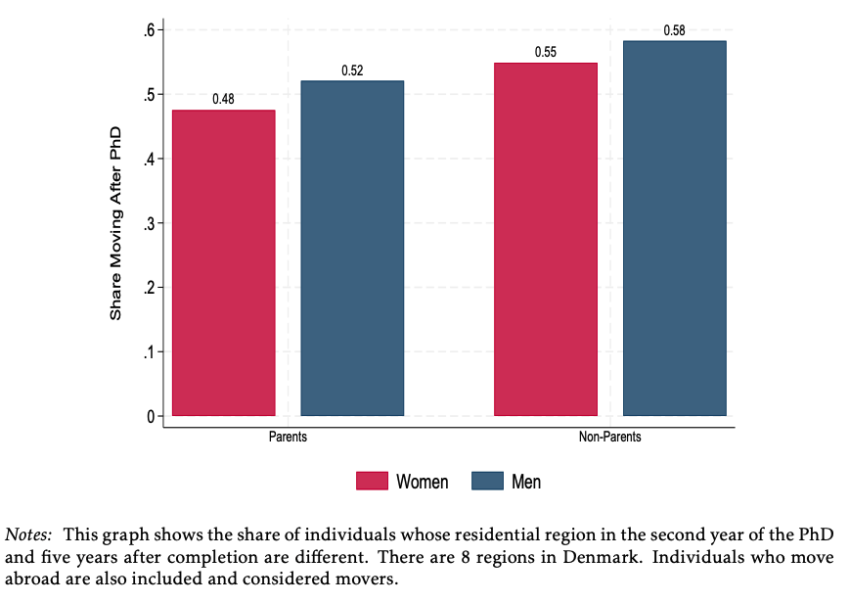
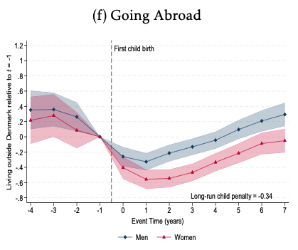
What is – Mobility constraints
Cairo et al., LSE, 2026

Slide 16
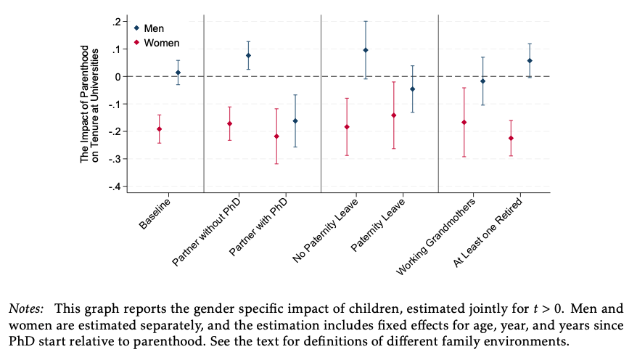
What is – Family environment
Cairo et al., LSE, 2026

Slide 17
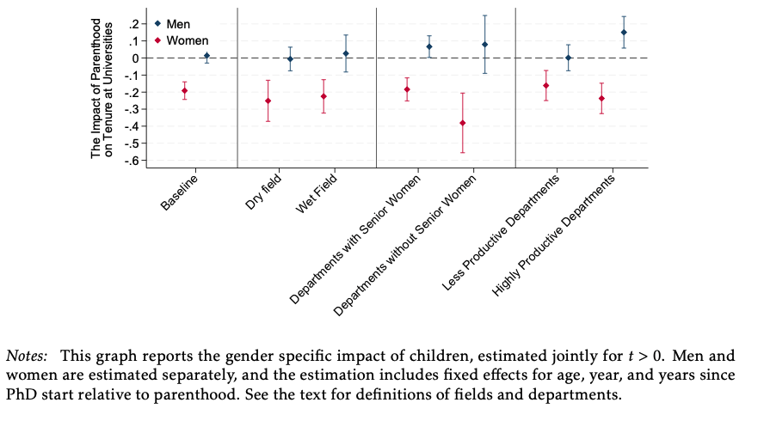
What is – Workplace environment
Cairo et al., LSE, 2026

Slide 18
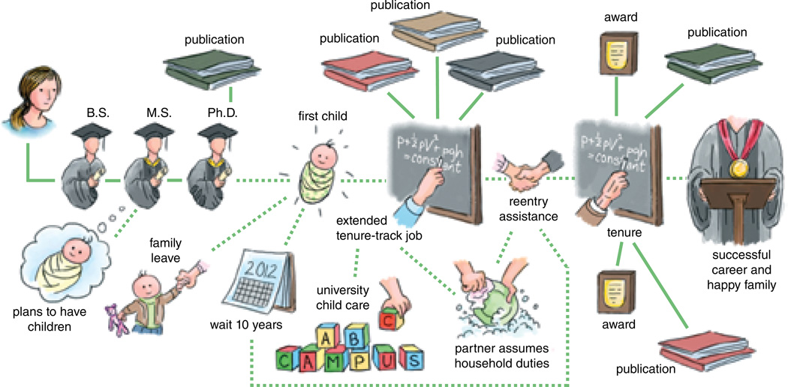
Open discussion points
What can people do at an individual / family / support system level?
What can change at the departmental and institutional levels?
How can tenure-track structures be made less rigid and more conducive to those who desire both - a successful career and a family?
Williams and Ceci, American Scientist, 2014

